Slide 1

Immigration AI Advisor
Team: Borderless.AI Sprint 3 Presentation
Notes:
Miles

Slide 2

Agenda
Team Member Roles and Responsibilities
Improvements
Project Description
Team Working Agreement
Personas
MVP
Technologies
Algorithms
Diagrams
Sprint 2 Recap
Product Backlog (Sprint1,Sprint 2)
Sprint Summary (Sprint 1, Sprint 2)
Sprint 3 Backlog
Metrics
Retrospective
Project Demo
API
Github link
Live Demo
Notes:
Miles

Slide 3





Team Member Roles and Responsibilities
Matt Borkowski
Developer
SCRUM Master
Miles ZhengFerrari
Developer
Team Leader
Nuvorish Paul
Developer
Raj Rahul Parekh
Developer
Santhosh Charudatta
Developer
All team members collaborate as developers, contributing to coding, testing, and feature development.
Notes:
Matt

Slide 4
Improvements
User Stories/Tasks
Type of user/user role
Story points- fibonacci numbers for Sprint 3
Table for backlog stories
Team velocity - history, average, etc
User story 2.6 in sprint 3
Api slides
Explaining Burndown chart in more detai during presentation
Notes:
Santhosh

Slide 5
Project Description
Project Name: Immigration AI Advisor
Team: Borderless.AI
Project Description:
Immigration AI Advisor is a AI-based application designed to assist international students with immigration-related queries by reading documents (I-20, I-94) and providing personalized advice based on immigration rules and policies.
Benefit Outcomes:
Faster, more accurate immigration advice for international students.
Reduced burden on international student offices with limited resources.
Improved efficiency in managing immigration-related queries within budget constraints.
Github Link:https://github.com/htmw/2024F-borderless.ai/wiki
Notes:
Santhosh

Slide 6
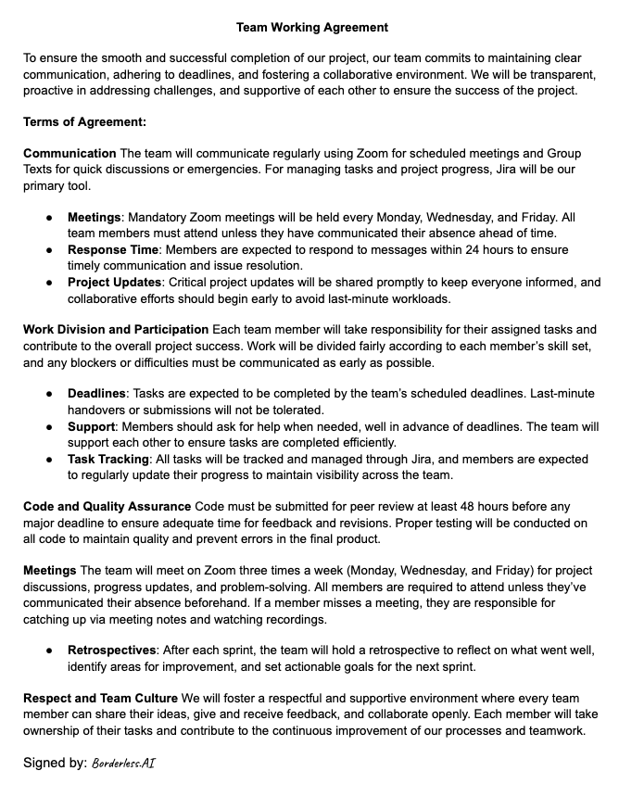
Team Working Agreement
Notes:
Miles

Slide 7

Personas
Name: Sarah Johnson
Age: 35
Role: International Student Adviser
Background:
Sarah has been an adviser for 8 years, handling hundreds of students each semester. She’s responsible for guiding them through immigration processes, ensuring compliance with visa regulations, and managing I-20 and I-94 forms.
Challenges:
Overwhelmed by repetitive tasks (e.g., checking I-20, I-94 documents). Struggles to keep up with changing immigration rules. Limited time for personalized student interactions due to workload.
Goals:
Automate routine tasks to reduce workload. Improve accuracy and efficiency in advising. Free up time for more complex student cases.
How Immigration AI Advisor Helps:
Automates document review (I-20, I-94).
Provides preliminary, personalized immigration advice.
Reduces manual workload, enabling Sarah to focus on complex cases.
Notes:
Santhosh

Slide 8

Personas
Name: Aakken Lee
Age: 22
Role: International Student, 3rd-year undergraduate
Background:
Aakken is studying Computer Science and is on an F-1 visa. He regularly deals with immigration paperwork like I-20s and I-94s, and needs to stay compliant with visa regulations to maintain his legal status in the U.S.
Challenges:
Needs quick, accurate advice on maintaining visa status. Often faces delays due to overburdened advisers. Uncertainty about document requirements or policy changes causes stress.
Goals:
Access immediate immigration information and advice. Avoid potential issues with immigration status.
How Immigration AI Advisor Helps:
Provides instant, accurate responses to common immigration queries.
Offers clear explanations of I-20 and I-94 documents.
Reduces reliance on advice availability for basic information.
Notes:
Santhosh

Slide 9

Personas
Name: Dr. Maria Rodriguez
Age: 50
Role: VP of Office of Global Services
Background:
Dr. Rodriguez’s role focuses on ensuring compliance with immigration regulations while enhancing student support and satisfaction. She’s responsible for strategic planning, resource allocation, and policy implementation.
Challenges:
Ensuring the institution stays compliant with evolving immigration laws. Balancing limited resources with the growing needs of international students.
Goals:
Improve efficiency to better serve students. Use data and automation to ensure compliance with immigration rules while respect the limited budget.
How Immigration AI Advisor Helps:
Streamlines immigration document processing, freeing up adviser resources.
Enhances support for international students, improving satisfaction and retention.
Notes:
Santhosh

Slide 10
MVP
Description:
Building upon this foundation, the current sprint introduces a new feature: the addition of abstract summaries to the retrieved documents. This enhancement provides users with concise and meaningful overviews of their documents, further simplifying the process of understanding and managing immigration-related paperwork. By combining automated key information extraction with high-level summaries, the MVP delivers greater value, reducing time spent on manual reviews and improving overall accessibility.
Key Features of the MVP:
PDF Upload: Users can upload an I-20 form through a web interface.
Data Extraction: The system automatically extracts and displays basic information (e.g., Name, Date of Birth).
Usability: Users can interact with the system, receive valuable information instantly, and ensure their immigration documents are processed accurately.
Value to Users:
The MVP solves a practical problem for students by saving time and reducing the complexity of manually reading their immigration documents. It provides immediate utility while laying the groundwork for future enhancements, such as more detailed document parsing and AI-based immigration advice.
Notes:
Raj

Slide 11
Technologies
Languages & Frameworks:
Python, Flask, FastAPI, Pytest, ReactJS, HTML, CSS
Artificial Intelligence:
TensorFlow, PyTorch, Chat GPT4o mini, BART, Claude
Any additional technology we may discover and add as we move on to each sprints.
Notes:
Matt

Slide 12
Algorithms
Regular Expressions/Pattern Matching
To recognize structure of, and extract information from, I-20 formatted forms
AI Large Language Models
LLM’s (Large Language Models), minimally trained language models, to provide the basis of a custom-trained, immigration-oriented “knowledge base”
TensorFlow/ PyTorch:
Might be used for statistical/quantitative analysis and transformation, in order to augment LLMs’ capabilities
Notes:
Matt

Slide 13
Diagrams
Architecture Diagrams
Context Diagram
ER Diagram
Sequence Diagram
State Diagrams
Notes:
Santosh

Slide 14
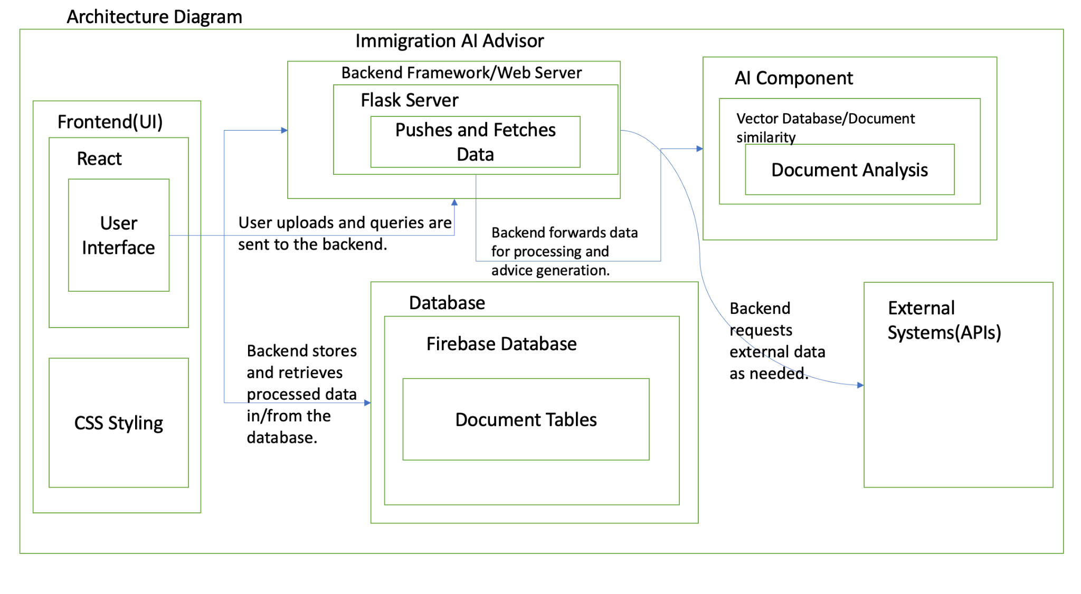
Architecture Diagram
Notes:
Santosh

Slide 15
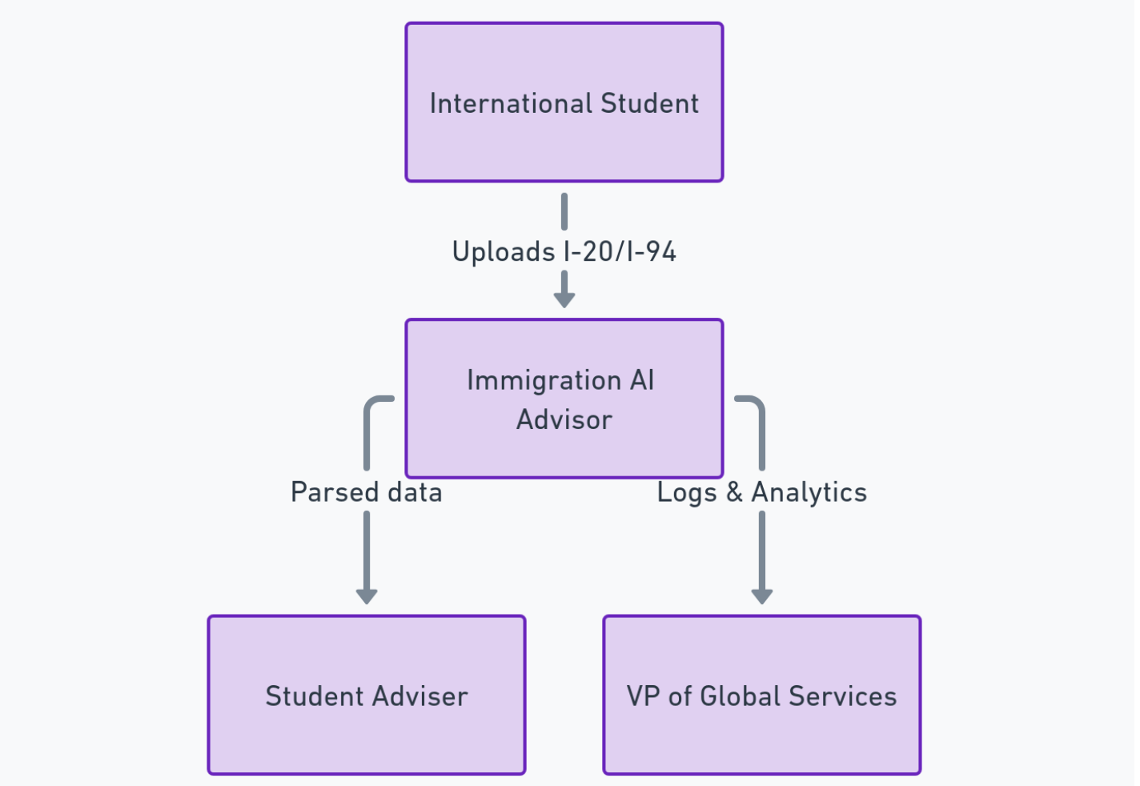
Context Diagram
Notes:
Santhosh

Slide 16
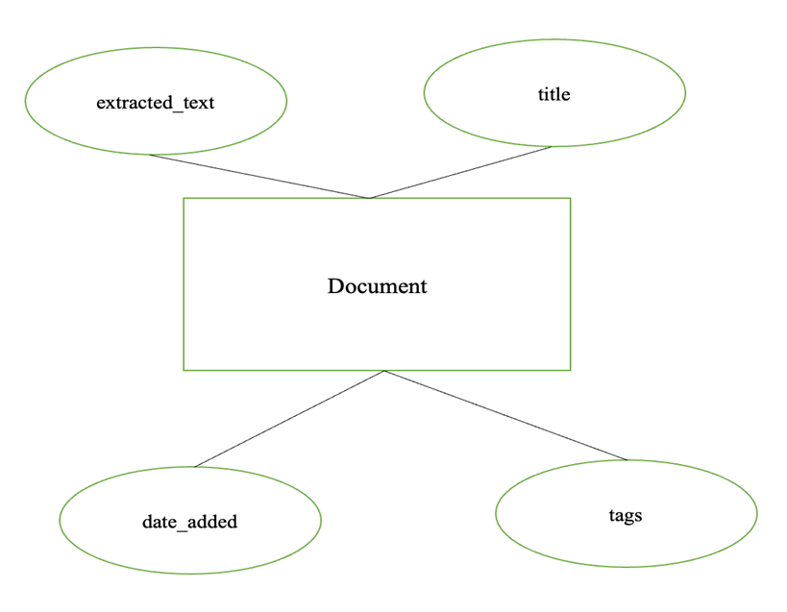
ER Diagram (Entity-Relationship Diagram)
Notes:
Santhosh

Slide 17
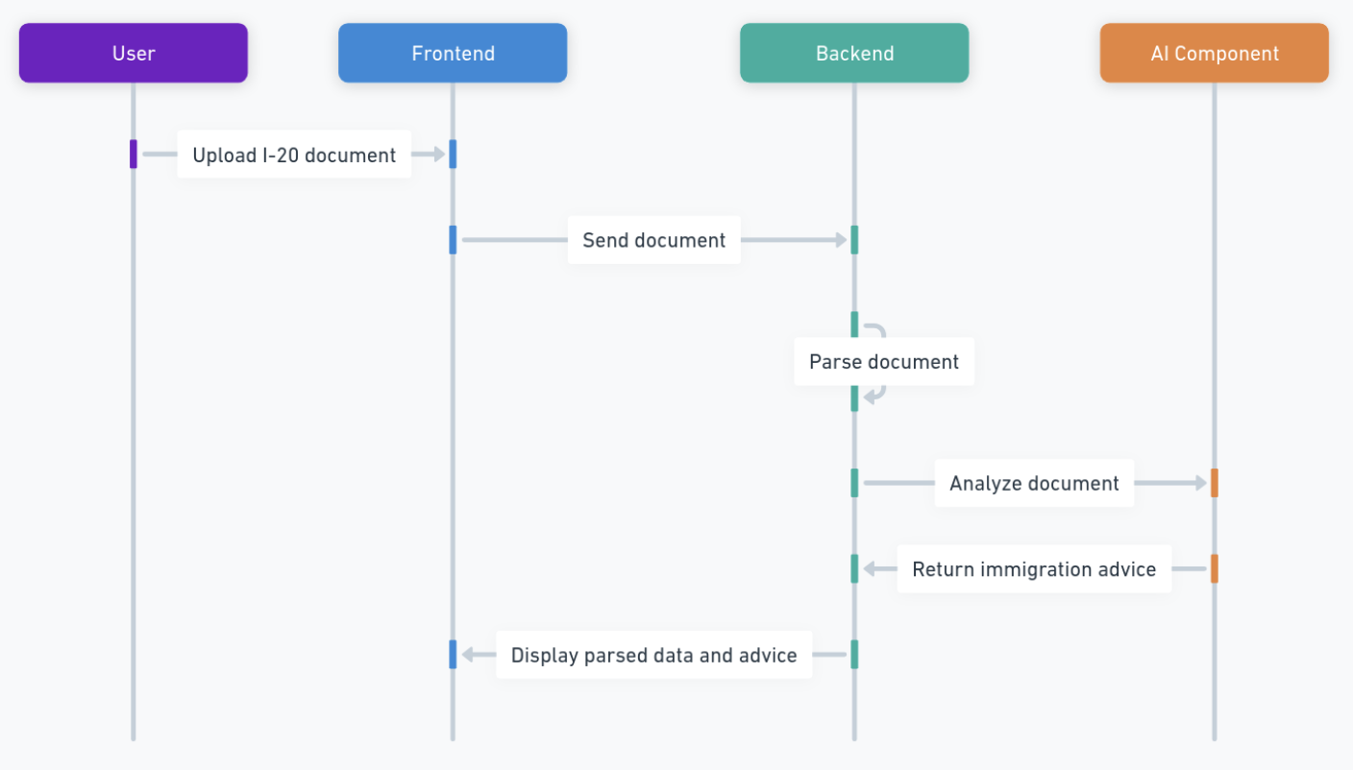
Sequence Diagram
Notes:
Santhosh

Slide 18
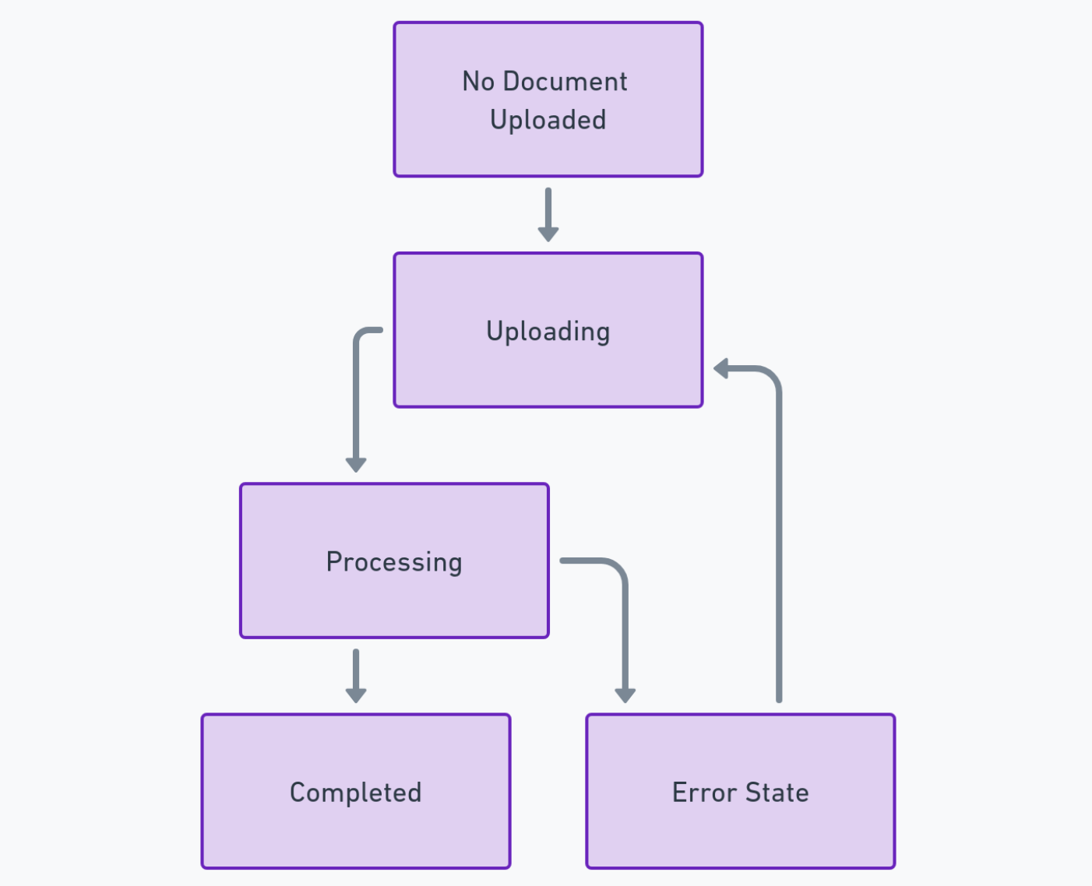
State Diagram
Notes:
Nuvorish

Slide 19
Sprint 2 Recap
Sprint Goals:
Objective: Introduce AI-driven functionality and enhance the user interface for the Immigration AI Advisor.
Implement a basic AI model to provide personalized advice.
Ensure flexibility for handling complex parsing in the future.
Develop a front-end chatbox for user interaction.
Key Accomplishments:
AI Model Development:Successfully implemented an AI model (using BERT or an RNN) trained on immigration-related queries and document data
Front-End Chatbox:Developed a user-friendly and functional chatbox.
Tagging System:Created a systematic tagging system for organizing and structuring AI training materials.
Document Collection:Gathered USCIS documents and compiled common immigration-related Q&A to train the AI model effectively.
Notes:
Raj

Slide 20
Project Backlog
Stories or Tasks for the Whole Project
Notes:
Miles

Slide 21
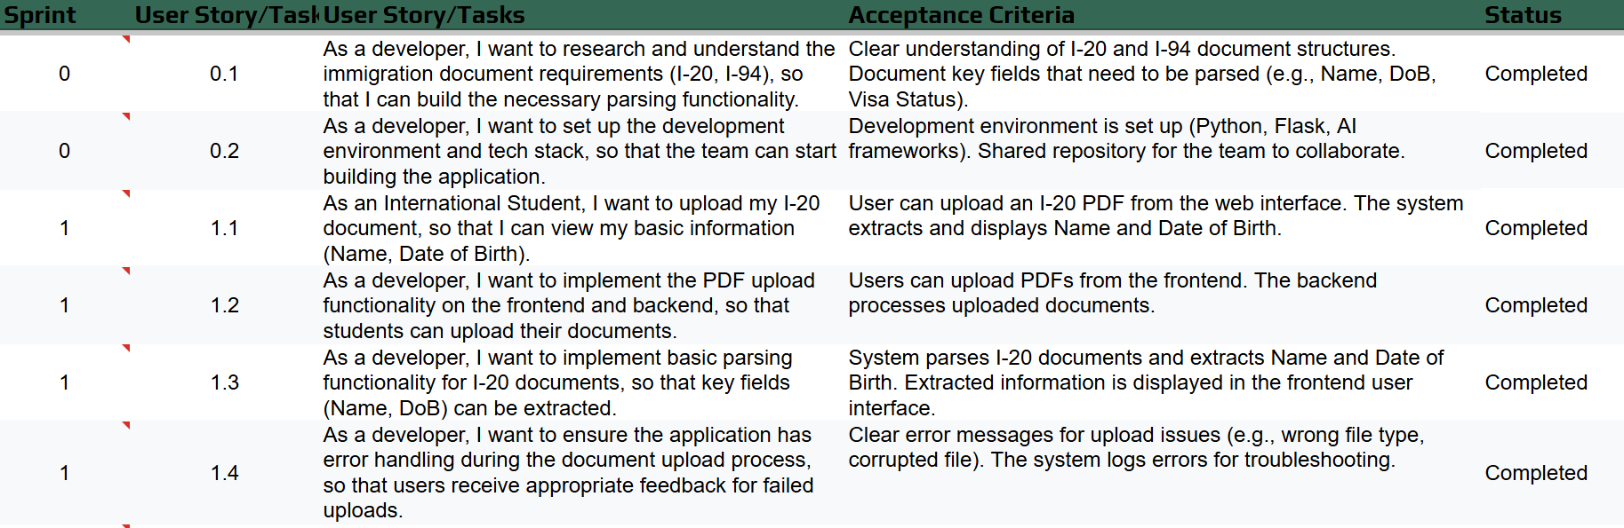
Notes:
Miles

Slide 22
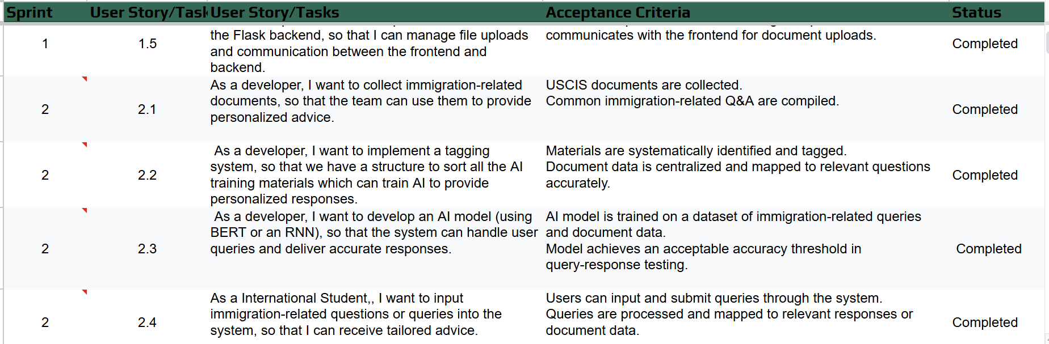
Notes:
Miles

Slide 23
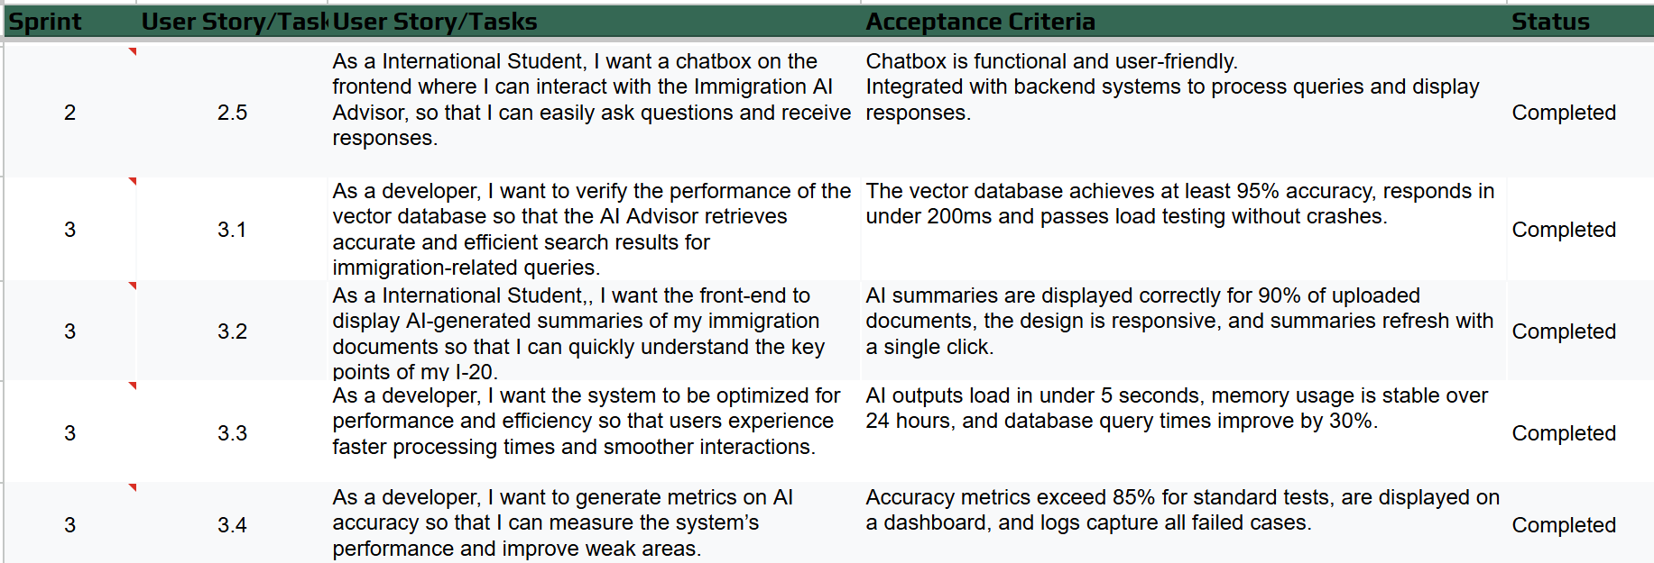
Notes:
Miles

Slide 24
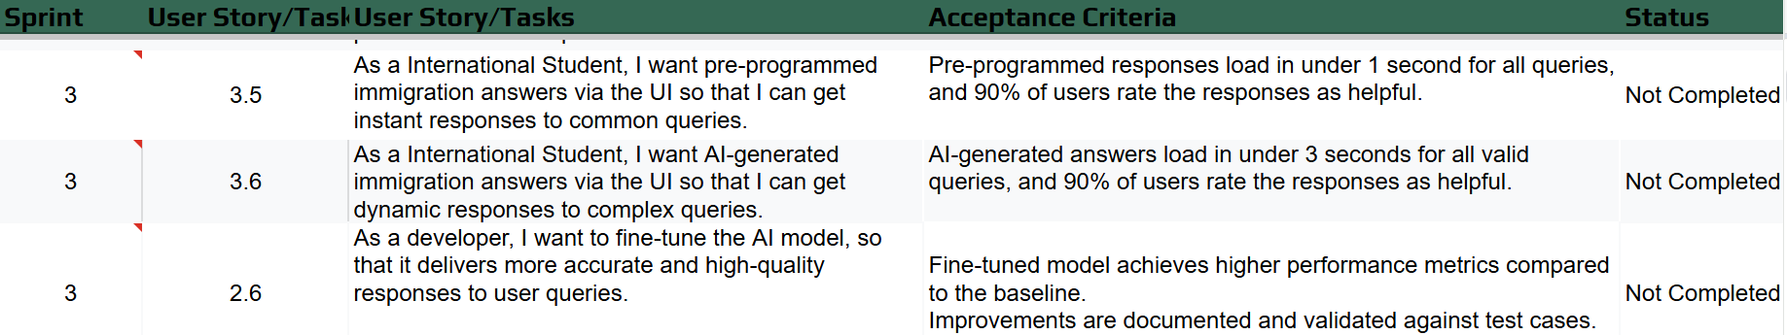
Notes:
Miles

Slide 25
Sprint Summary (Sprint 0)
Problem: International students face delays in getting immigration advice due to understaffed offices and complex requirements, creating a pressing need for an automated solution
Solution: AI-based application that reads immigration documents (I-20, I-94) and provides immediate, accurate advice based on current regulations
Technology Stack: Discussed combination of modern tools - Java/Python/ReactJS for development, TensorFlow/PyTorch for AI implementation, focusing on document analysis capabilities
Core Deliverable: Development of an AI advisor that can interpret immigration documents and cross-reference them with latest regulations to provide accurate guidance
Quality Standards: Mandatory 48-hour code review period before deadlines, with strict testing requirements and no last-minute submissions allowed
Communication Protocol: 24-hour response requirement for messages, mandatory meeting attendance, and regular Jira updates to maintain project momentum
Development Process: Agile methodology with clear documentation in GitHub, regular retrospectives, and continuous improvement focus through sprint reviews and adjustments
Notes:
Nuvorish

Slide 26
Sprint Summary (Sprint 1)
Successfully implemented core MVP functionality - PDF upload and basic document parsing for I-20 forms, extracting key fields like Name and Date of Birth
Achieved 100% completion rate (24/24 story points) for all planned user stories and tasks, demonstrating effective sprint planning and execution
Established full-stack infrastructure with Python/Flask backend and ReactJS frontend, setting up essential communication between layers
Implemented comprehensive error handling system for document uploads, including user-friendly messages and system logging
Set up project architecture following best practices, as shown in architecture diagrams with clear separation of frontend, backend, AI component, and database layers
Completed all essential test cases across different components (frontend upload, backend processing, document parsing, error handling)
Created working prototype demonstrated in project demo, showing successful document upload and information extraction capabilities
Developed robust team workflow with regular meetings (Monday/Wednesday/Friday schedule) and clear communication channels (Zoom, Group Texts, Jira)
Identified areas for improvement in sprint retrospective, including task estimation and workload distribution, leading to actionable items for Sprint 2
Prepared foundation for Sprint 2 by planning I-94 document integration and AI component enhancement, with clear acceptance criteria defined
Notes:
Nuvorish

Slide 27
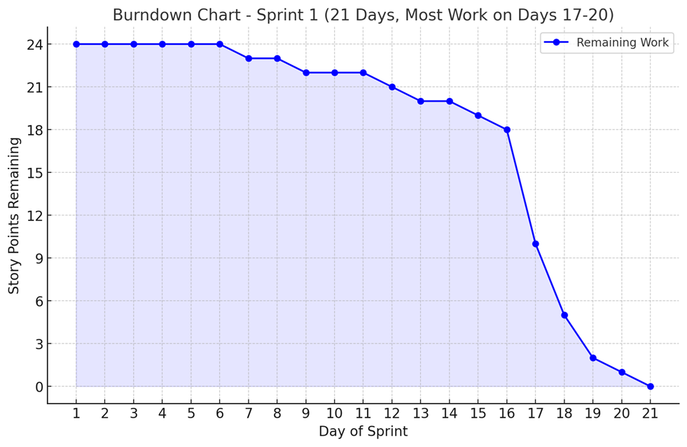
Sprint Summary (Sprint 1,Burndown chart)
Notes:
Milles

Slide 28
Sprint Summary (Sprint 2)
The team successfully completed 5 out of 6 planned user stories, achieving a completion rate of 78.28% (36 out of 46 story points)
Major accomplishments included implementing the AI model with BERT/RNN for handling immigration queries and document analysis
The team developed a functional chatbox interface integrated with backend systems for user interaction
A tagging system was implemented to organize AI training materials and map documents to relevant queries
The team successfully collected and compiled immigration-related documents and Q&A content from USCIS
One task remained incomplete: fine-tuning the AI model for improved accuracy (10 story points)
The frontend design was improved and integrated with the backend for document processing and query handling
Basic AI functionality was implemented, allowing the system to provide personalized immigration advice
The team identified communication as an area for improvement, particularly regarding WhatsApp responsiveness and meeting attendance
For Sprint 3, the team committed to stricter deadlines, including completing components 72 hours before due dates and conducting daily standups
Notes:
Raj

Slide 29
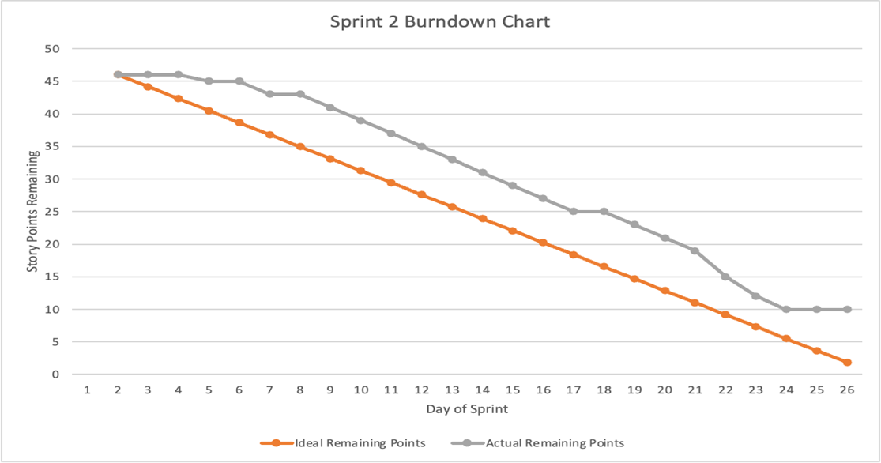
Sprint Summary (Sprint 2,Burndown chart)
Notes:
Raj

Slide 30
Sprint 3 Backlog
Stories or Tasks committed for this Sprint
User Story/Task ID: 3.1
Description: As a developer, I want to verify the performance of the vector database so that the AI Advisor retrieves accurate and efficient search results for immigration-related queries.
Acceptance Criteria: The vector database achieves at least 95% accuracy, responds in under 200ms, and passes load testing without crashes.
Story Points: 3
User Story/Task ID: 3.2
Description: As a student, I want the front-end to display AI-generated summaries of my immigration documents so that I can quickly understand the key points of my I-20.
Acceptance Criteria: AI summaries are displayed correctly for 90% of uploaded documents, the design is responsive, and summaries refresh with a single click.
Story Points: 3
User Story/Task ID: 3.3
Description: As a developer, I want the system to be optimized for performance and efficiency so that users experience faster processing times and smoother interactions.
Acceptance Criteria: AI outputs load in under 5 seconds, memory usage is stable over 24 hours, and database query times improve by 30%.
Story Points: 5
Notes:
Milles

Slide 31
Sprint 3 Backlog
Stories or Tasks committed for this Sprint
User Story/Task ID: 3.4
Description: As a developer, I want to generate metrics on AI accuracy so that I can measure the system’s performance and improve weak areas.
Acceptance Criteria: Accuracy metrics exceed 85% for standard tests, are displayed on a dashboard, and logs capture all failed cases.
Story Points: 8
User Story/Task ID: 3.5
Description: As a student, I want pre-programmed immigration answers via the UI so that I can get instant responses to common queries.
Acceptance Criteria: Pre-programmed responses load in under 1 second for all queries, and 90% of users rate the responses as helpful.
Story Points: 8
Notes:
Milles

Slide 32
Sprint 3 Backlog
Stories or Tasks committed for this Sprint
User Story/Task ID: 3.6
Description: As a student, I want AI-generated immigration answers via the UI so that I can get dynamic responses to complex queries.
Acceptance Criteria: AI-generated answers load in under 3 seconds for all valid queries, and 90% of users rate the responses as helpful.
Story Points: 13
User Story/Task ID: 2.6
Description: As a developer, I want to fine-tune the AI model so that it delivers more accurate and high-quality responses to user queries.
Acceptance Criteria: Fine-tuned model achieves higher performance metrics compared to the baseline, and improvements are documented and validated against test cases.
Story Points: 5
Notes:
Milles

Slide 33
Sprint 3 Backlog
Test Cases
Test Case 1: Verify End-to-End System Workflow
Description: Ensure the system processes I-20 uploads and generates summaries and responses seamlessly.
Steps: Upload an I-20 document, view the summary, and submit a question.
Expected Result: The system completes all actions smoothly, with summaries and responses delivered within 5 seconds total.
Test Case 2: Verify Vector Database Accuracy
Description: Ensure the vector database retrieves accurate results for test queries.
Steps: Upload sample documents, execute test queries, and compare results to expected outputs.
Expected Result: At least 95% of queries return accurate results.
Test Case 3: Verify Front-End Display of AI Summaries
Description: Confirm that AI-generated summaries display correctly in the UI.
Steps: Upload an I-20 document and check the "Summary" section of the UI.
Expected Result: Summaries are displayed accurately and match backend outputs.
Notes:
Santhosh

Slide 34
Sprint 3 Backlog
Test Cases
Test Case 4: Test Responsiveness of the Summary Section
Description: Ensure the AI summaries section is responsive on different devices.
Steps: Open the web application on desktop, tablet, and mobile, and check the layout.
Expected Result: The summary section is fully responsive on all screen sizes.
Test Case 5: Verify System Performance Under Load
Description: Test system stability and response times with multiple concurrent users.
Steps: Simulate 50 users submitting queries simultaneously and monitor system behavior.
Expected Result: The system remains stable, with no crashes and response times under 5 seconds.
Notes:
SANTHOSH

Slide 35
Sprint 3 Backlog
Test Cases
Test Case 6: Validate Accuracy of Pre-Programmed Answers
Description: Verify pre-programmed answers match predefined FAQs accurately.
Steps: Submit 10 predefined FAQ queries and compare responses with expected answers.
Expected Result: All pre-programmed answers are correct and match expected outputs.
Test Case 7: Test AI-Generated Answer Response Time
Description: Ensure AI-generated answers are delivered within acceptable time limits.
Steps: Submit a complex immigration-related question and measure response time.
Expected Result: AI-generated answers load in under 3 seconds.
Notes:
SANTHOSH

Slide 36
Sprint 3 Backlog Stories Completed
User Story/Task ID: 3.1
As a developer, I want to verify the performance of the vector database so that the AI Advisor retrieves accurate and efficient search results for immigration-related queries.
User Story/Task ID: 3.2
As a student, I want the front-end to display AI-generated summaries of my immigration documents so that I can quickly understand the key points of my I-20.
User Story/Task ID: 3.3
As a developer, I want the system to be optimized for performance and efficiency so that users experience faster processing times and smoother interactions.
User Story/Task ID: 3.4
As a developer, I want to generate metrics on AI accuracy so that I can measure the system’s performance and improve weak areas.
User Story/Task ID: 3.5
As a student, I want pre-programmed immigration answers via the UI so that I can get instant responses to common queries.
Notes:
Milles

Slide 37
Sprint 3 Backlog Stories Not Completed
User Story/Task ID: 3.6
As a student I want AI-generated immigration answers via the UI so that I can get dynamic responses to complex queries.
User Story/Task ID: 2.6
As a developer, I want to fine-tune the AI model, so that it delivers more accurate and high-quality responses to user queries.
Notes:
Matt

Slide 38
Metrics: Sprint 3 Velocity
Total Story Points: 45
Completed Story Points: 27
Not Completed Story Points: 18
Velocity: 27
Notes:
Raj

Slide 39
Metrics: Team's Historical Velocity and Average
Sprint 1 Velocity: 24
Sprint 2 Velocity: 36
Sprint 3 Velocity: 27
Average: 29
Notes:
Matt

Slide 40
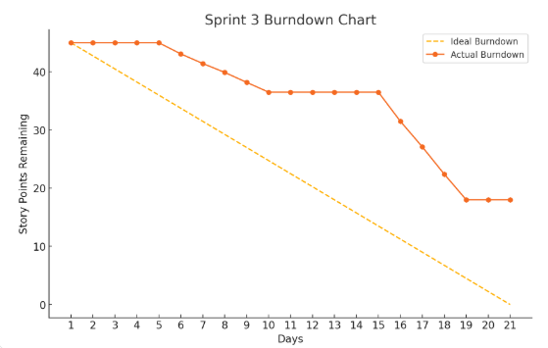
Metrics Sprint 3 Burndown Chart
Notes:
Miles

Slide 41
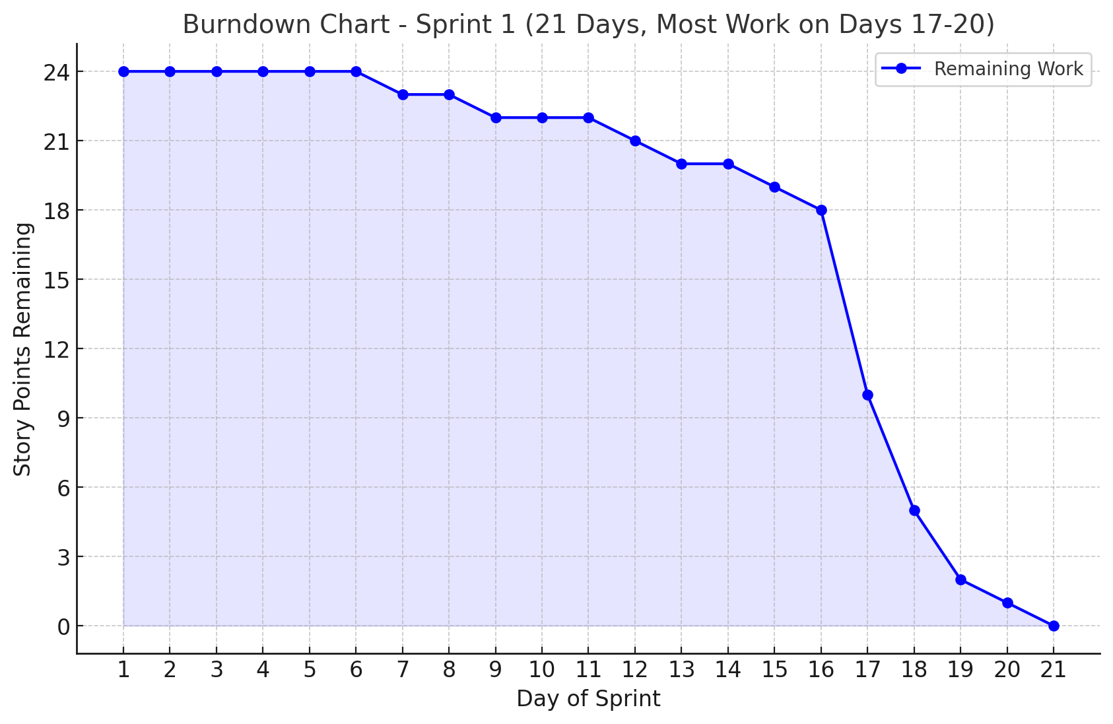
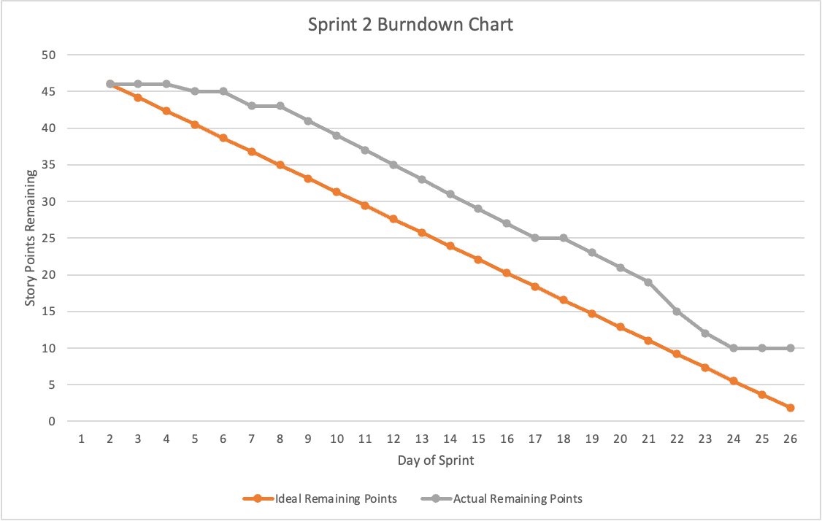
Metrics: Historical Burndown Chart
Notes:
Miles

Slide 42
Metrics: Completed/Committed Ratio
Sprint 3:
Completed: 27
Not Completed: 18
Total Story Points: 45
Completed/Committed Ratio: 27/45 = 60%
Notes:
Nuvorish

Slide 43
Team's historical Completed/Committed Ratio
Sprint 1:
24/24 = 100%
Sprint 2:
36/46 = 78.26%
Sprint 3:
27/45 = 60%
Average 87/ 115 = 75.7%
Notes:
Nuvorish

Slide 44
Retrospective
What Went Well?
Completed many user stories despite busy schedules.
Positive feedback and strong teamwork; pulled everything together successfully.
Improved coordination with tools like Jira and better communication (e.g., text responses).
What Can Be Improved?
Create more sub-tasks to ensure stories don't fall behind.
Better monitor and manage items to reduce stress.
Respect deadlines while balancing personal responsibilities.
Actionable Items:
Divide tasks into smaller, time-bound sub-tasks.
Make daily personal detailed to-do lists for better personal and work task tracking.
Practice active listening , respect and follow through on shared information.
Notes:
Santhosh

Slide 45
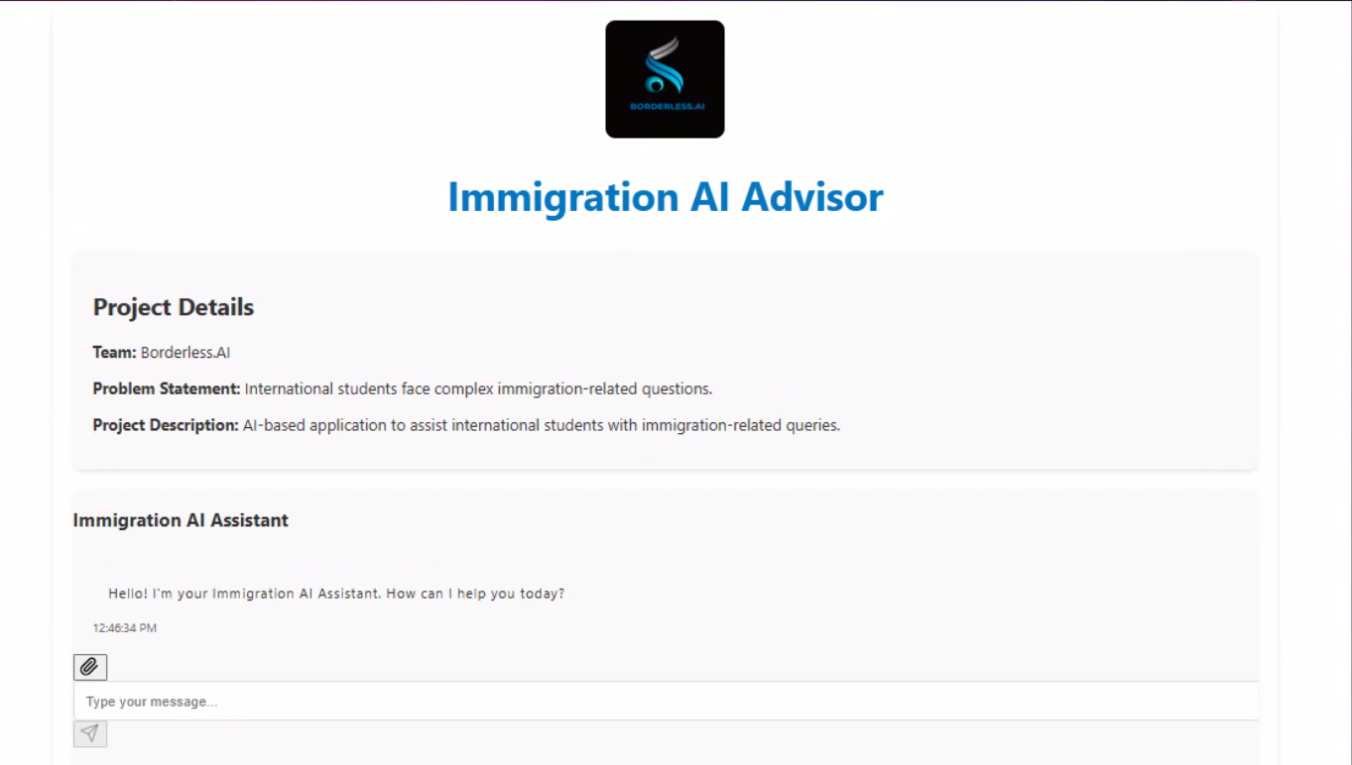
Project Demo
Notes:
Matt

Slide 46
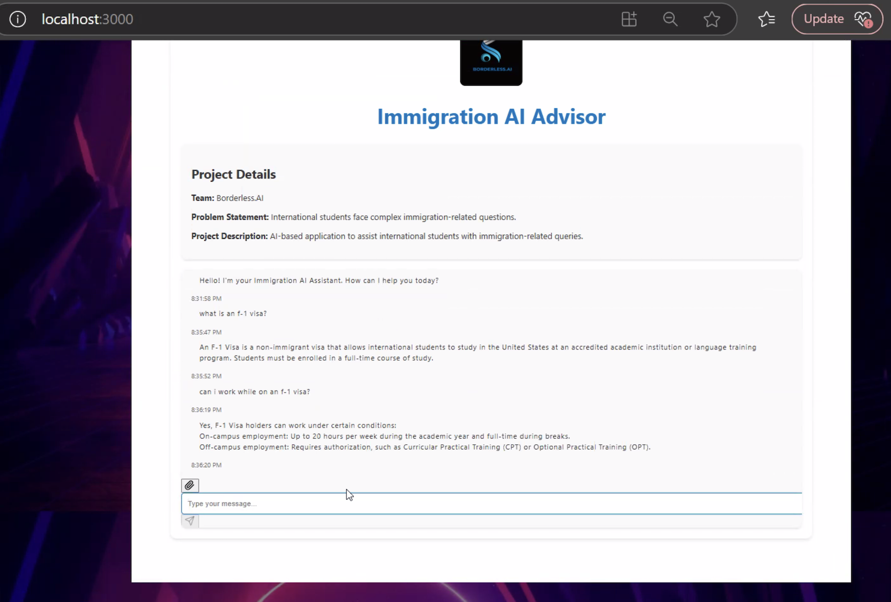
Notes:
Matt

Slide 47
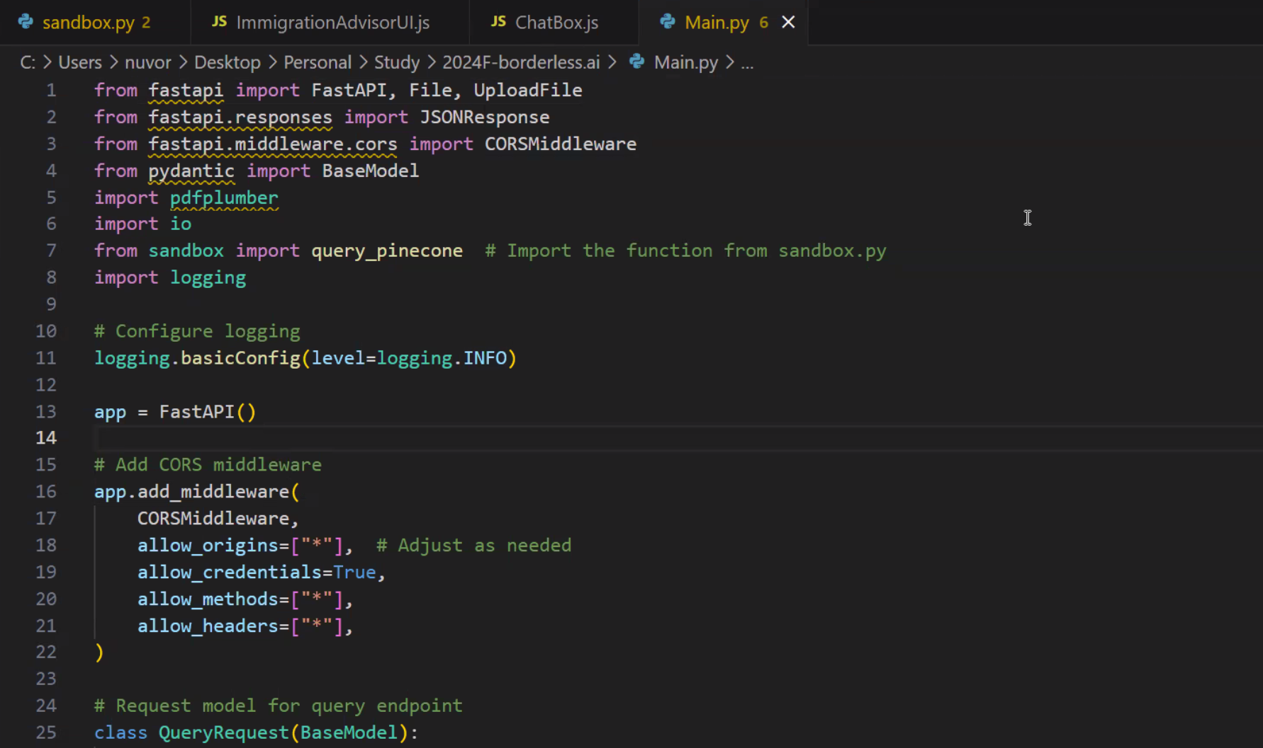
Project Demo
Notes:
Matt

Slide 48
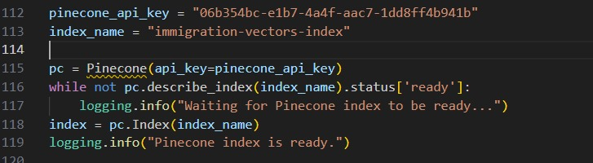
PINECONE API
Notes:
Matt

Slide 49
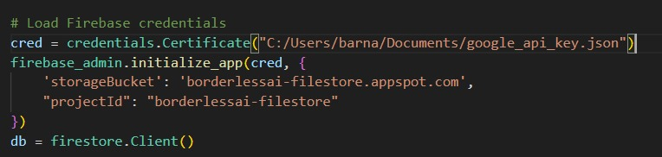
FIREBASE API
Notes:
Matt

Slide 50
Github Link
https://github.com/htmw/2024F-borderless.ai/wiki
Notes:
Matt

Slide 51
Live Application Demo
Notes:
Nuvorish

Slide 52
THANK YOU!
Notes:
Nuvorish

